Slide 1
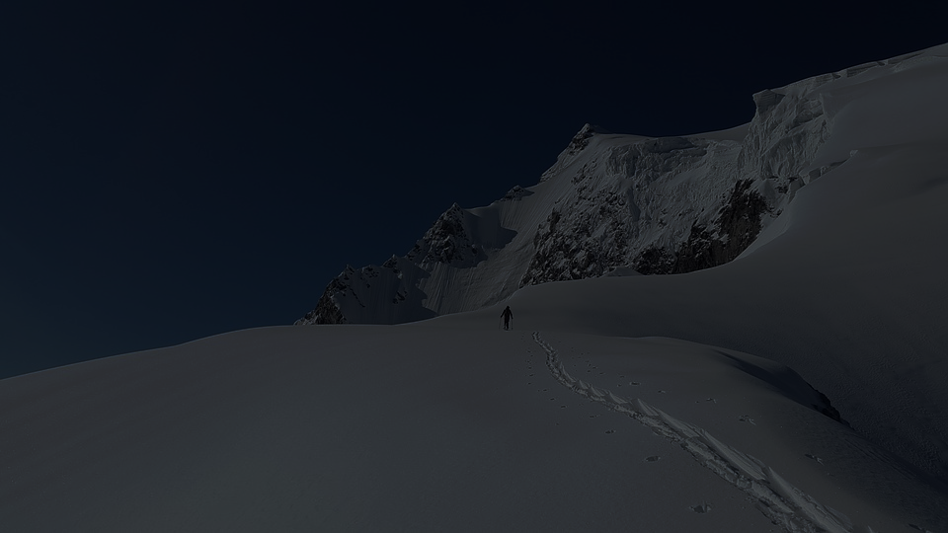

SAP UI5 & FIORI with OData TRAINING
Anubhav Oberoy
Day – 25

Slide 2

Agenda – Day 25
Creating Object page
Adding custom fragment to the App

Slide 3
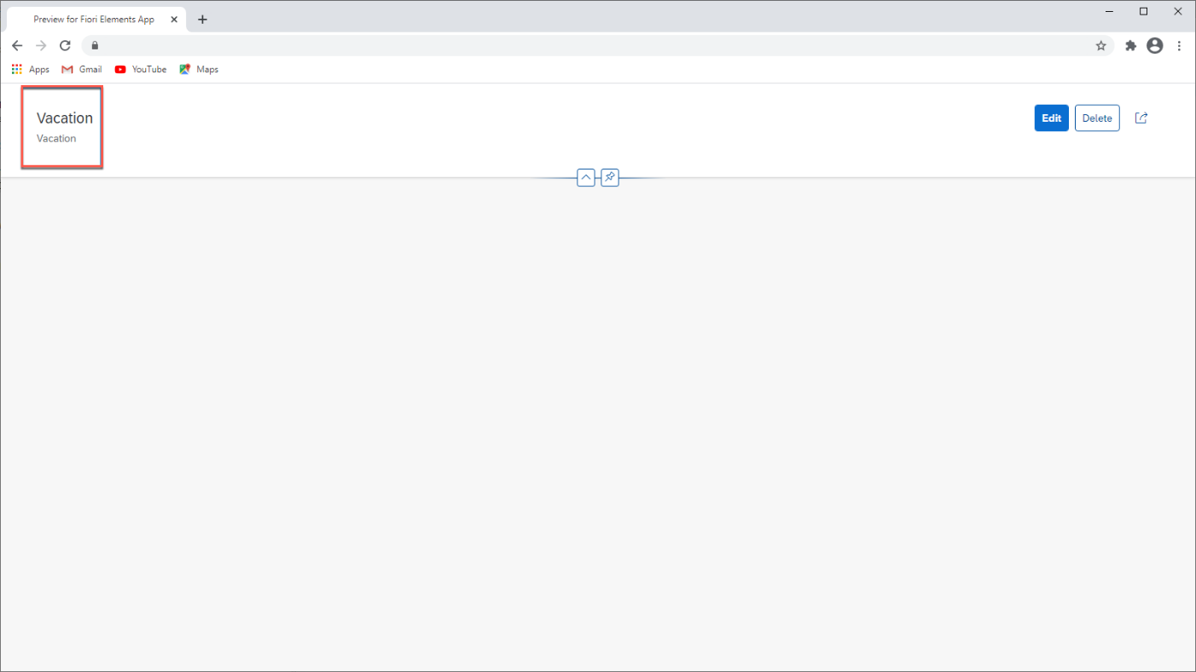
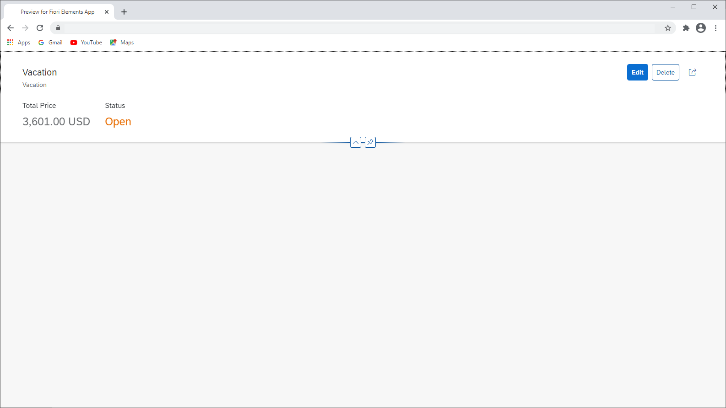
Header of the object page
Header Info

Slide 4
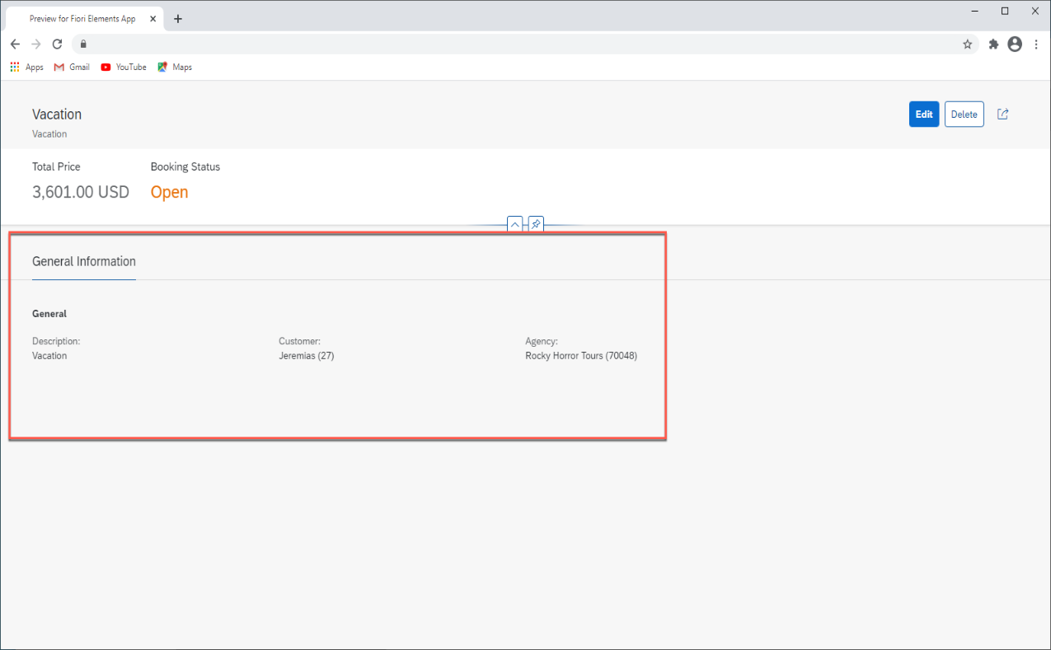
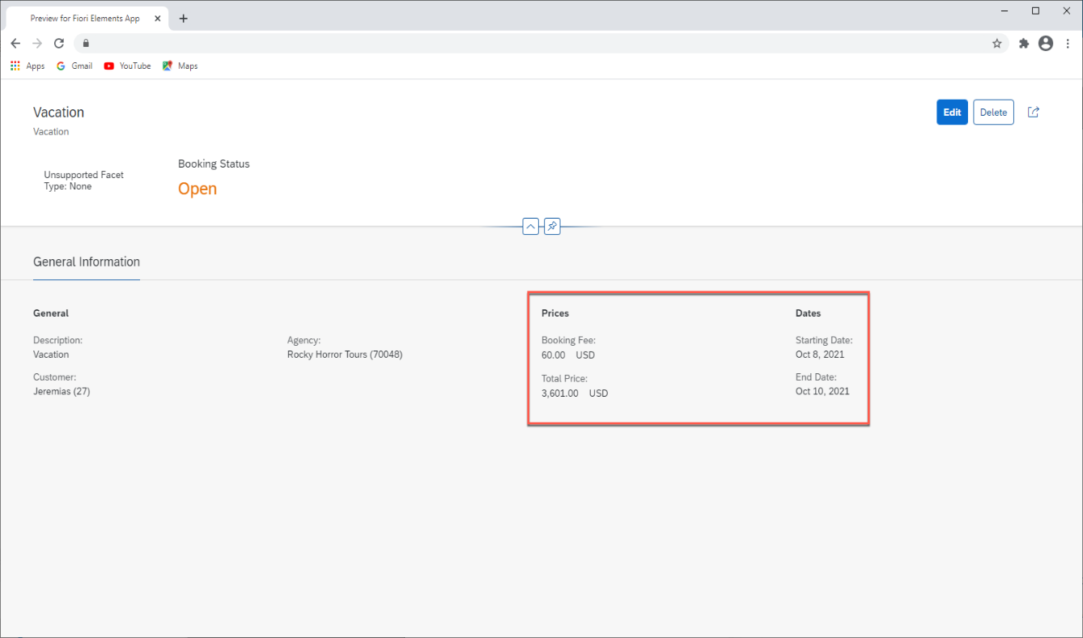
Adding Facets
Travel Request
Sales Order HDR
1..*
Bookings
Sales Order ITEM

Slide 5
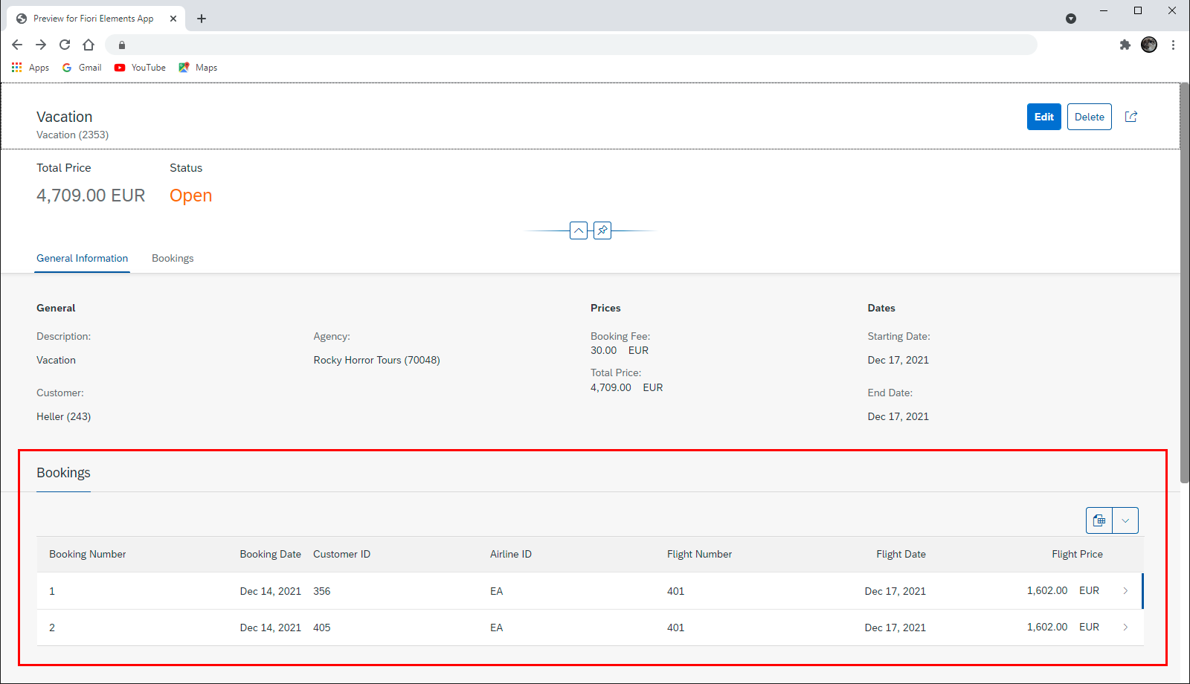
Adding Facet for Booking table

Slide 6
Adding Custom fragment ext
<core:FragmentDefinition xmlns:core="sap.ui.core"
xmlns="sap.m"
xmlns:macros="sap.fe.macros"
xmlns:vbm="sap.ui.vbm"
displayBlock="true">
<VBox>
<!-- HBox class="">
<Text text="The bookings were confirmed on" class="sapUiTinyMarginEnd"/>
<macros:Field readOnly="true" metaPath="CreatedAt" id="custom-flightdate"/>
<Text text="by" class="sapUiTinyMarginBeginEnd"/>
<macros:Field readOnly="true" metaPath="AgencyID" id="custom-airline"/>
</HBox -->
<vbm:AnalyticMap width="100%" xmlns:l="sap.ui.layout" height="600px" initialPosition="-47.48339103742949; 48.70365903454684;0" initialZoom="2" class="sapUiMediumMarginTop">
<vbm:vos>
<vbm:Routes>
<vbm:Route position="8.682127;50.110924;0; -73.780968;40.641766;0" color="rgb(204,0,0)" colorBorder="rgb(255,255,255)" linewidth="3" routetype="Geodesic" />
<vbm:Route position="-73.780968;40.641766;0; -122.389977;37.615223;0" color="rgb(255,128,0)" colorBorder="rgb(255,255,255)" linewidth="3" routetype="Geodesic" />
<vbm:Route position="-122.389977;37.615223;0; 8.682127;50.110924;0" color="rgb(0,153,76)" colorBorder="rgb(255,255,255)" linewidth="3" routetype="Geodesic" />
</vbm:Routes>
<vbm:Spots>
<vbm:Spot position="8.682127;50.110924;0" tooltip="Frankfurt am Main (FRA)" labelType="Default" labelText="Frankfurt am Main (FRA)" labelPos="5" />
<vbm:Spot position="-73.780968;40.641766;0" tooltip="New York (JFK)" labelType="Default" labelText="New York (JFK)" labelPos="5" />
<vbm:Spot position="-122.389977;37.615223;0" tooltip="San Francisco (SFO)" labelType="Default" labelText="San Francisco (SFO)" labelPos="5" />
</vbm:Spots>
</vbm:vos>
</vbm:AnalyticMap>
</VBox>
</core:FragmentDefinition>

Slide 7
Header of the object page

Slide 8
Header of the object page

Slide 9
Header of the object page

Slide 10
Header of the object page

Slide 11
Fiori Elements - List Report Application
The list report offers powerful features for finding and acting on relevant data sets. It is often used as an entry point for navigating to the item details, which are usually shown on an object page.
List Report
Object Page

Slide 12

End of Day 25

Slide 13

Questions

Slide 14

Anubhav Oberoy

Slide 15


We’re committed to empower you to be
Most Desirable Resource
through powerful training solutions.
We build the workforce of the future.
250+
Corporate Clients
30,000+
Learners Trained
25000+
Learners Placed
FREE WEBINARS
Sign up for free webinars with industry experts every fortnight!
Enroll Now!
Contact us today!
https://anubhavtrainings.com/

Slide 16




More from AnubhavTrainings.com

Slide 17
Title
Content

